Slide 1








Building Your vCISO Practice: Future-Proofing your vCISO Practice
Operate
vCISO Series | Session 6 of 6

Slide 2
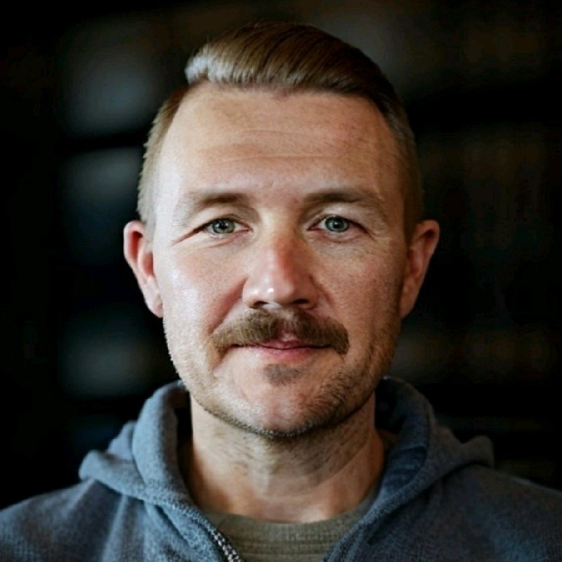
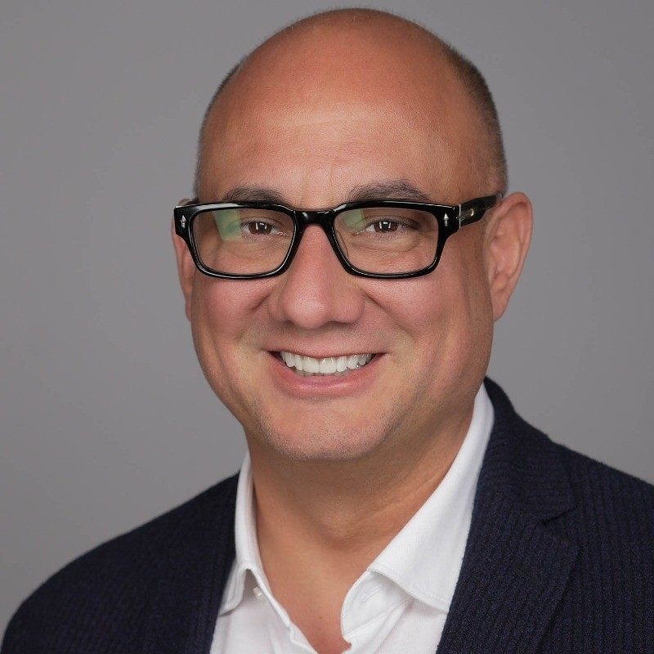
Jesse Miller
Luis Giraldo
Founder at PowerPSA,
creator of the PowerGRYD™ vCISO System
Chief Evangelist at ScalePad

Slide 3


https://go.scalepad.com/vCISO-Resources
Session 5 Recap
Previous Sessions Resources
Cross-Functional Prep and Offer Readiness
Realistic Client Identification and Goal Setting
Setting Up Feedback Loops

Slide 4


Agenda
01 02 03
The Shifting Mindset Strategic approach to future-proofing Building agile service cadences

Slide 5



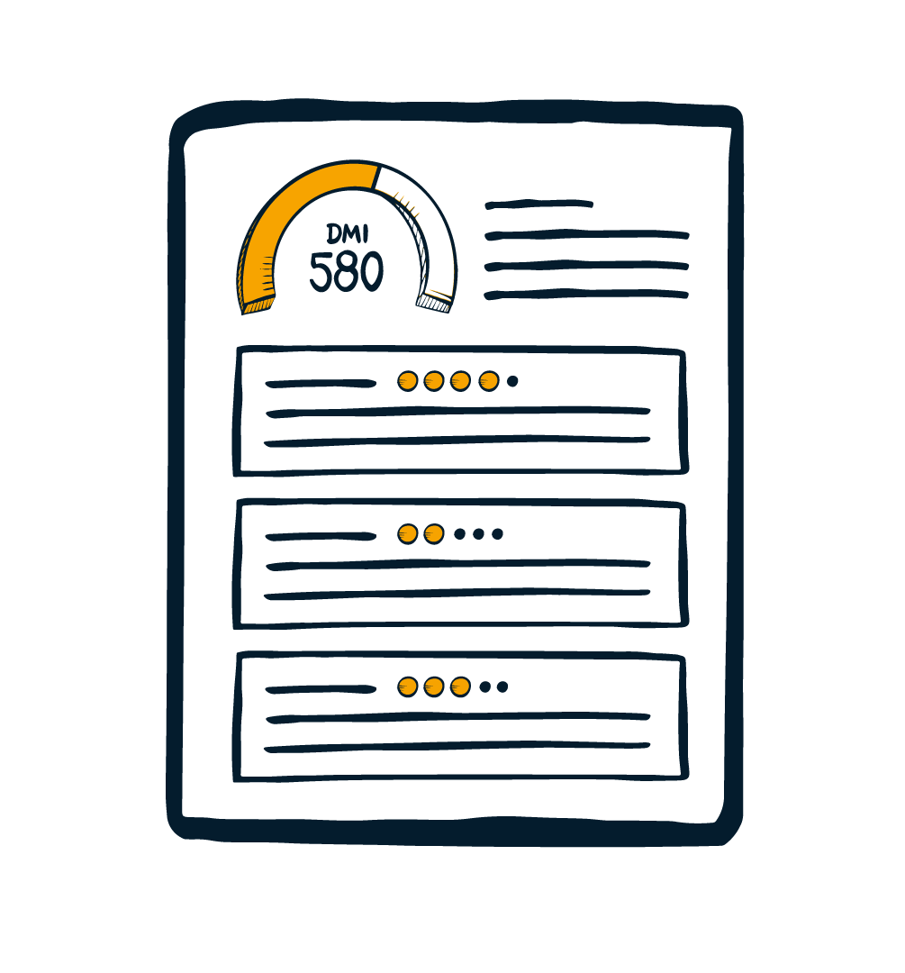



Building Your vCISO Practice - Development Roadmap
START
INITIATE
Consensus to build vCISO program
EVALUATE
People/Process/Tech
Strategy and Approach
PLAN
Go-to-Market, Offer Matrix, Resources, Logistics
IMPLEMENT
Deploy processes, playbooks, and procedures.
DEVELOP
Design sales, operations, and service delivery methods
ITERATE
Identify primary clients, deliver, iterate, adjust
LAUNCH
Apply lessons learned, perform full market attack
OPERATE
Perform continuous delivery and improvement cycles

Slide 6
Today: Operate
Building Your vCISO Practice
A Continuous Improvement Approach
Make our walk match our talk.

Slide 7
Poll
How would your clients describe your vCISO offering?
Building Your vCISO Practice
Notes:
Poll: How would your clients describe your vCISO offering?
Answer options:
They manage our security tools and systems design.
They help us check compliance boxes.
They help us write policies and do risk assessments.
They work intimately with our executive team to accelerate our business with security.

Slide 8
Customer Mindset
The Shifting Tides of Mindset
What are SMBs and MMEs actually thinking about?
The transition from project to program
From “IT problem” to “business risk”
From “checklists” to “continuous governance”
From “tool ownership” to “accountability ownership”
Standing up to legal and regulatory scrutiny
Risk conversations have entered the building

Slide 9
MSP Mindset is Shifting Too
MSP Mindset

Slide 10
Continuous Improvement Approaches
The Shifting Tides of Mindset
MSP Mindset is shifting too
Change Leadership — a Program, not a Project
OKRs
MSP centricity moving to customer centricity
From “jobs to be done” to cross-functional acumen
“The future of MSP is co-managed”

Slide 11





Continuous Deployment
Discover
Plan
Execute
Steer
Prove

Slide 12
Customer Success Growth Loop
Business Discovery
Know their business like your own & elicit goals
Delivering Results that Win
Business Impact
Value Alignment
Deliver value through measurable outcomes
Align services & initiatives around goals

Slide 13
Poll
What documented processes do you have in place to “future-proof” your MSP?
Building Your vCISO Practice
Notes:
(multiple choice)
Poll: How do you go about “future-proofing” your MSP?
Answer options:
Add AI to the website and call it “innovation”
Capture the customer voice and shape strategy accordingly
Incorporate constant questioning and retrospectives as a discipline
Build multi-year plans for additional service offerings and expanded market segments

Slide 14
How do you do this with vCISO?
Building Your vCISO Practice

Slide 15
How do you do this with vCISO?
Standardize How You Customize
Library of repeatable processes
Conviction
ICP
Stakeholders
Cadences
Performance metrics — What are we reporting to who?

Slide 16
Where do programs fail?
Building Your vCISO Practice

Slide 17
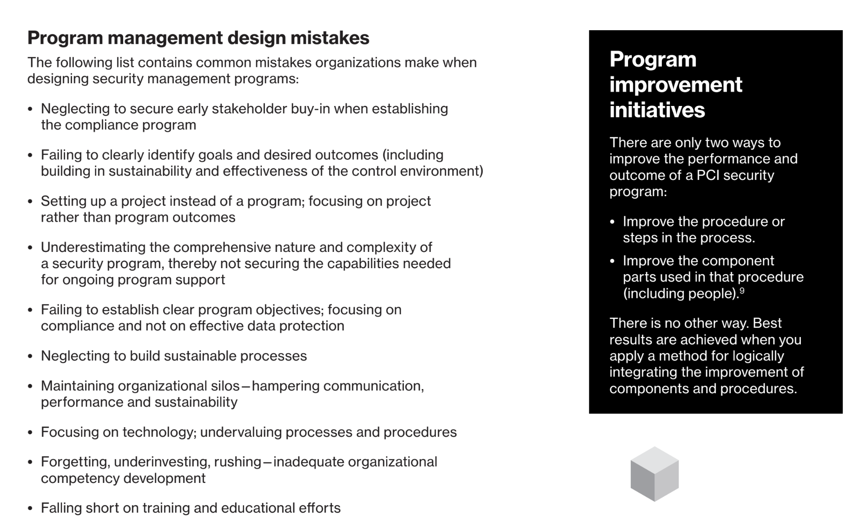

Building Your vCISO Practice
Source:
Verizon 2023 Payment Security Report

Slide 18
How does this look in practice?
Building Your vCISO Practice

Slide 19
How does this look in practice?
Stakeholders
Map the client’s organizational decision-making process
Identify each stakeholder and what each one cares about
Elicit goals and objectives
Categorize goals into need to do / want to do

Slide 20
How does this look in practice?
Cadences
Think about how you do it in your own organization
Don’t wedge vCISO into a cadence that’s not fit for purpose
Strategic and/or executive cadences
Security operations cadence
Reporting cadences

Slide 21
How does this look in practice?
Metrics
Don’t conflate throughput with results
OKR structure to focus on outcomes
Leading indicators (progress, project status)
Lagging indicators (change delivered, effectiveness achieved)

Slide 22
Listen to the music Listen for and capture customer triggers, and reframe them for your various teams
Bonus Cadence

Slide 23


Learn More About
Cybersecurity Compliance
ControlMap is a compliance automation platform for MSPs designed to expedite the compliance process for over 50+ frameworks such as SOC 2, ISO 27001, and more. The platform boosts users’ security posture, develops sales pipelines, and adds peace of mind to security teams.
Scan to Learn More!

Slide 24
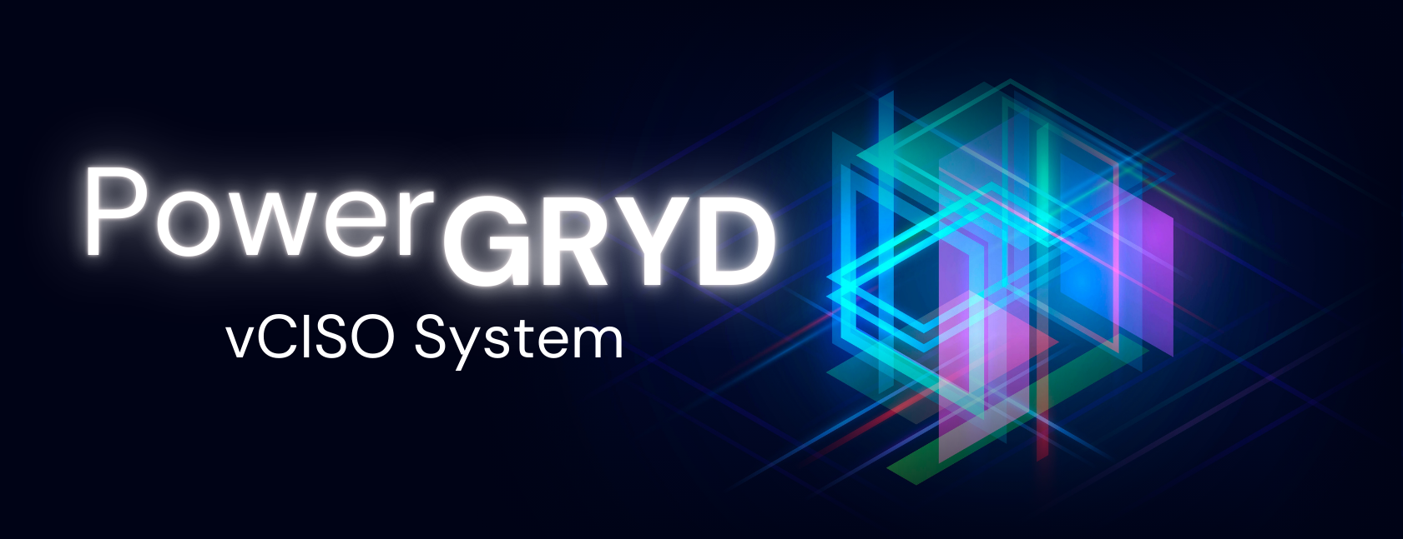
Learn more about the PowerGRYD™ vCISO System
https://PowerGRYD.group

